Slide 1
Photoperiod Determination of Several Plant Select® Perennials
Rebekah Savage

Slide 2

Plant Select® Research @CSU
“Plant Select’s goal is to create smart plant choices for a new American Landscape inspired by the Rocky Mountain Region”
Plant Select® is a collaboration between CSU, Denver Botanic Garden, and professional horticulturists
CSU conducts research on new introductions into the Plant Select® program
  Problems growers may be having
Scutellaria scordifolia ‘Pat Hayward’
Zauschneria garettii ‘PWWG01S’
Photoperiod determination of these perennials may be the solution
Notes:
Plant select aims for plants that are adaptable to
-low water
-arid environments
-non-invasive

Slide 3
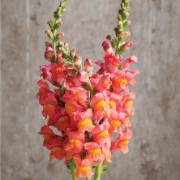
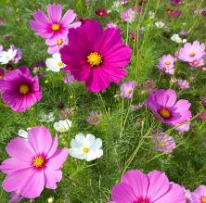
Photoperiodism
The duration of night which initiates flowering response
Long Day
  Obligate long-day
  (aka critical)
  Facultative long-day
Short Day
  Obligate short-day
  Facultative short-day
Day neutral
  Geranium
  Impatiens
Snapdragon
Cosmos
Notes:
Obligate long-day plants require day lengths longer than a certain critical length in order to flower
Facultative long-day plants initiate flowers under any day length but will flower earlier when under long-days
Obligate short-day plants require day lengths shorter than a certain critical length in order to flower
Excellent paper on physiology behind photoperiod – Stephen D. Jackson “Plant Responses to Photoperiod” 2008

Slide 4
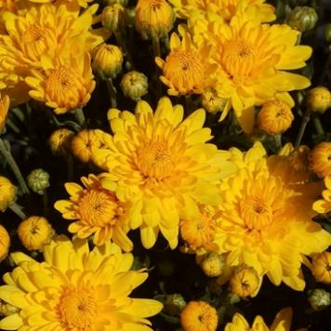
Photoperiod History
Chrysanthemum
  Cultivars flower when day length is LESS than 12 hours
  Blooming period is SHORT
      LOW return for growers
In the 1920’s Garner and Allard described photoperiod response of many plants
  LD, SD, Day Neutral
By 1923, Chrysanthemum was distinguished as a short day plant

Slide 5
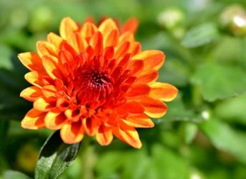
Photoperiod & Greenhouse Management
Today – with photoperiod control Chrysanthemum is produced all year long
Chrysanthemum photoperiod research is extensive
  2012 – Datta and Gupta
    Cultivar specific response time to SD
    Cultivar morphological response to long days
    Cultivar morphological response to short days

Slide 6
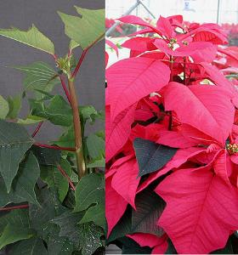
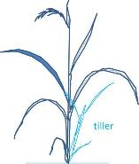
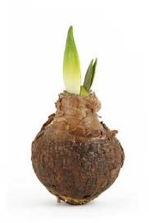
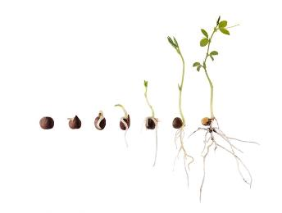
Photoperiod & Greenhouse Management
Promote flowering
Suppress flowering
Seed germination
Stem elongation
Tillering in grasses
Bulb formation
Rooting of cuttings

Slide 7
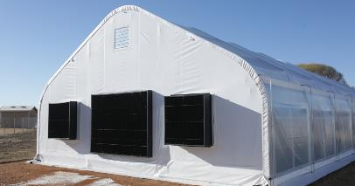

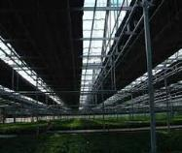
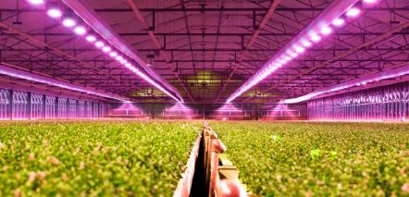

Photoperiod & Greenhouse Management
Light deprivation greenhouses
Black shade cloth
Supplemental Lighting

Slide 8
Photoperiod & Stock Plant Management @ csu
CSU conducts research on new introductions into the Plant Select® program
Research on Plant Select® perennials problematic due to constant flowering
    Scutellaria scordifolia ‘Pat Hayward’
    Zauschneria garettii ‘PWWG01S’
Discussion with Plant Select®
  Preliminary research with the goal of suppressing Scutellaria flowering
  If the preliminary research yielded results → more advanced study
Notes:
Left: Natural daylight conditions ~11 hours
Right: Light limited plants ~ 8 hours

Slide 9
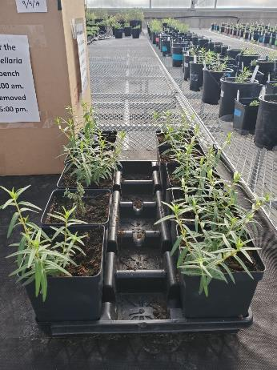
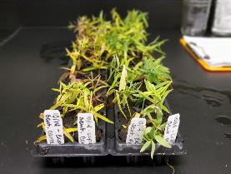
Photoperiod & Stock Plant Management @ csu
Preliminary experiment:
15 plants per treatment
Natural light ~11 hours
Photoperiod regulated – 16:8
5 weeks
Propagation study following
photoperiod experiment

Slide 10
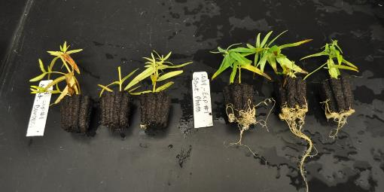
Photoperiod & Stock Plant Management @ csu
Preliminary Results
  Control
  15/15 plants had visible reproductive tissue
  46% rooting
  Photoperiod 16:8
  1/15 plants had visible reproductive tissue
  88% rooting
Goal for growers
is 90% rooting

Slide 11
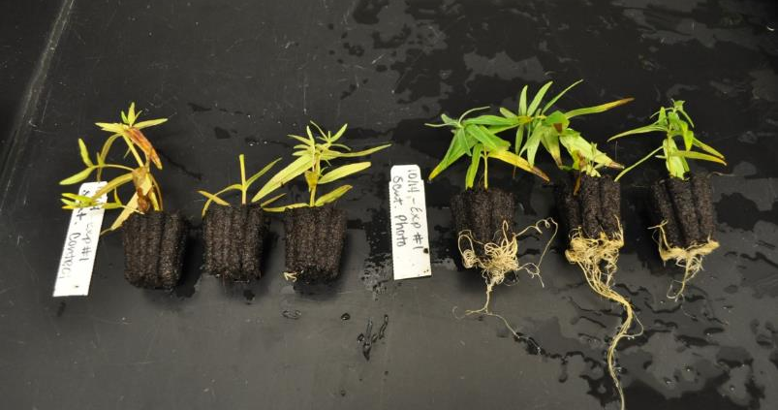
Photoperiod & Stock Plant Management @ csu
Reproductive tissue: low quality stock plant → low quality cuttings → low rooting %

Slide 12
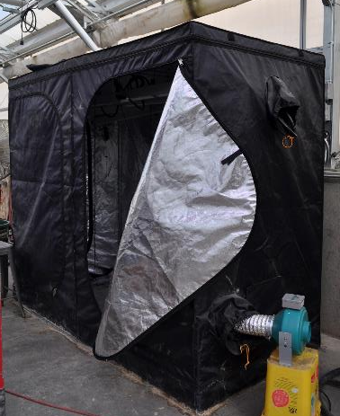
Current Research

Slide 13
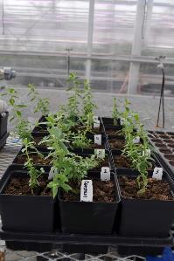
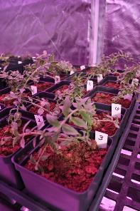
experimental design
15 plants in each treatment
Control
  ‘Normal’ greenhouse conditions
    ~10 hours - ~11.5 hours
  Night - 65°F
  Day – 73°F
Grow Tent 1
  14:10
  Night ~65°F
  Day ~80°F
Grow Tent 2
  16:8
  Night ~65°F
  Day ~78°F
Notes:
Originally, we were going to do 16:8 to repeat preliminary experiment. With discussion with CHREF board, we decided to create a greater difference between the photoperiods and decided on 14:10

Slide 14
Experimental Design
Photoperiod determination
Take Cuttings from all treatments
Propagation Study

Slide 15
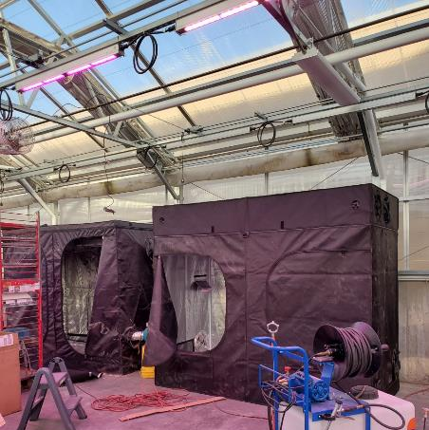

Materials: Photoperiod
Notes:
Gorilla Grow Tent $

Slide 16
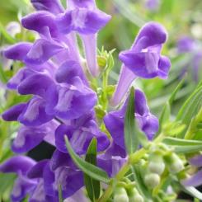
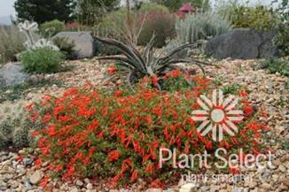
Materials: Photoperiod
Scutellaria scordifolia ‘Pat Hayward’
  Problematic for growers and research
  Constant flowering
  Continuation on preliminary research
Zauschneria garettii ‘PWWG01S’
  Problematic for growers and research
  Constant flowering

Slide 17
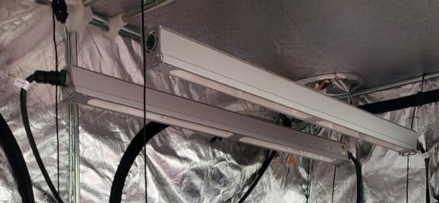
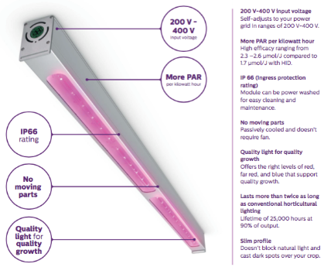
Materials: Photoperiod
Phillips LED Lights
    DR/W MB 200-400V
    High output Deep Red White
Notes:
Phillips LED Lights
DR/W MB 200-400V

Slide 18
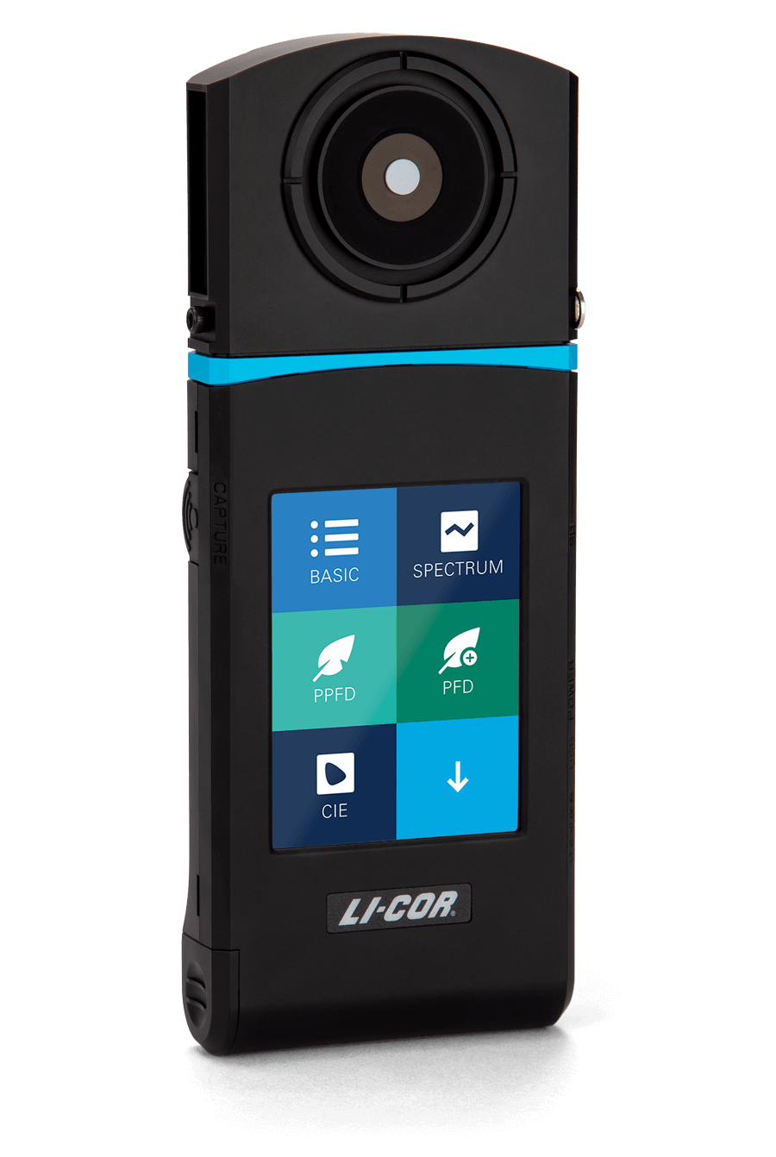
Materials: Photoperiod
LI-COR spectrometer
Initial Spectrometer Data
Light Quality | 14 Dark 10 Light | 16 Dark 8 Light | Control
Red | 356.77 | 394.81 | 43.65
Fr | 4.36 | 4.26 | 31.00
R:FR | 81.82 | 92.79 | 1.41
Total PPFD | 424.69 | 468.74 | 117.41
Total PFD | 429.04 | 473.00 | 148.41
Total PPFD in the grow tents is within 50 micro moles
Red to far red ratio is HIGH in the grow tents and LOW in the control

Slide 19

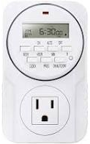
Materials: Photoperiod
Notes:
14-4-14 fertilizer –Green Care Fert
Pindstrup
Li-cor spectrometer
Phillips – DR/W MB 200-400V
Gorilla Grow Tent
Active Air 4” fans
Plugs from Gulley Greenhouse

Slide 20
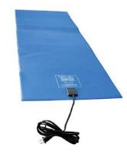

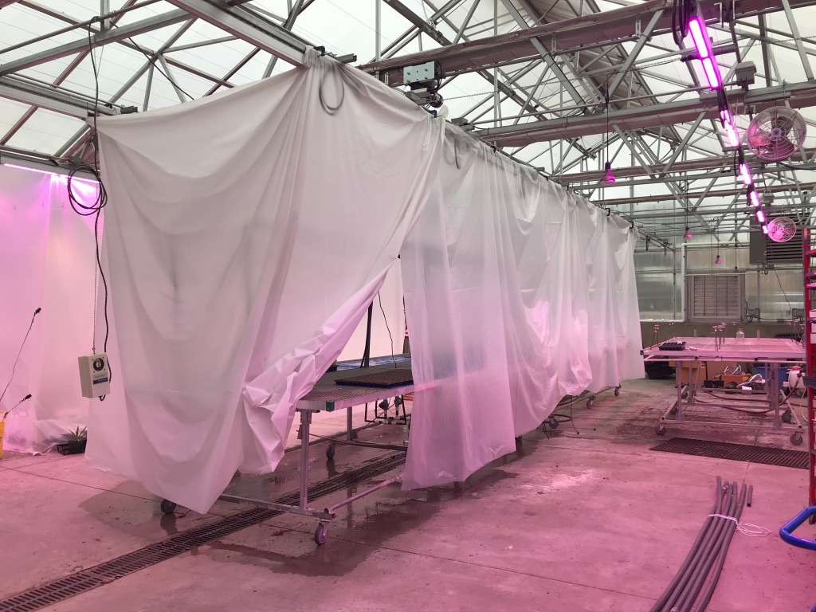
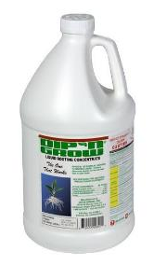
Materials: Propagation
Dip n’ Grow
Jiffy 72 plug trays
Mist bench
  Overhead
  misters
Heating mats

Slide 21
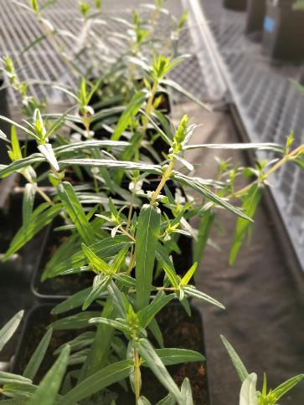
Data collection: initial
Initial heights and widths
Initial Spectrometer readings
Weekly temperature
Weekly visible assessment
  No reproductive tissue
  Presence of buds
  Presence of flowers

Slide 22
Data Collection: Final
Final heights and widths
Final spectrometer readings
Final root grade
  1-5
Soil analysis
Propagation
Weekly rooting data
  Count visible roots
  Goal is 90% rooting
Notes:
90% rooting is the goal because this is the number growers need to achieve for propagation to be financially viable

Slide 23
Discussion points
Varying temperatures
  Grow tents tend to be hotter than the greenhouse
  Green house temp increase => Increase in the grow tent temp
Difference in light quantity and quality
  In the control: Low red: far red
  In the grow tents: High red: far red
Initial Spectrometer Data
Light Quality | 14 Dark 10 Light | 16 Dark 8 Light | Control
Red | 356.77 | 394.81 | 43.65
Fr | 4.36 | 4.26 | 31.00
R:FR | 81.82 | 92.79 | 1.41
Total PPFD | 424.69 | 468.74 | 117.41
Total PFD | 429.04 | 473.00 | 148.41

Slide 24
Future Research
Repeat of Experiment #1
  16:8
  14:10
  Control
    ~11.5-12.5 hours
If photoperiod is not determined – additional photoperiods will be tested
  12:12
  10:14

Slide 25

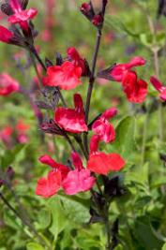
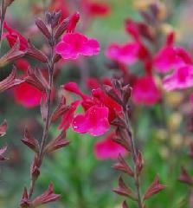
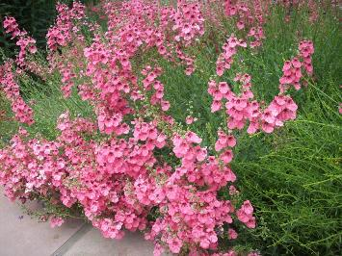
Future Research
Expand research to additional Plant Select® perennials
  Salvia greggi ‘Furman’s Red’
  Salvia greggi ‘Wild Thing’
  Diascia ‘Coral Canyon’

Slide 26

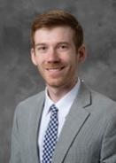
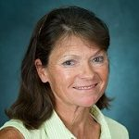


Thank you
Dr. James Klett
Dr. Joshua Craver
Anthony Percival
Lauryn Schriner
Sean Markovic
Ronda Koski
Specialty Crop Block Grant
Gulley Greenhouse
Plant Select®

Slide 27
Questions?
Thank you!

